Slide 1
North Region Advisory Council
General Meeting
October 19, 2022
Monarch High School

Slide 2
Agenda
Call to Order, Meeting Etiquette, Introductions/Attendance
Approval or Correction of Minutes
Election
School Spotlight!
School Safety and Security
Committee Reports
Open forum
SAF Updates
Call to Action!
Announcements
Adjourn

Slide 3
September Minutes
Review, Correct, Approve

Slide 4
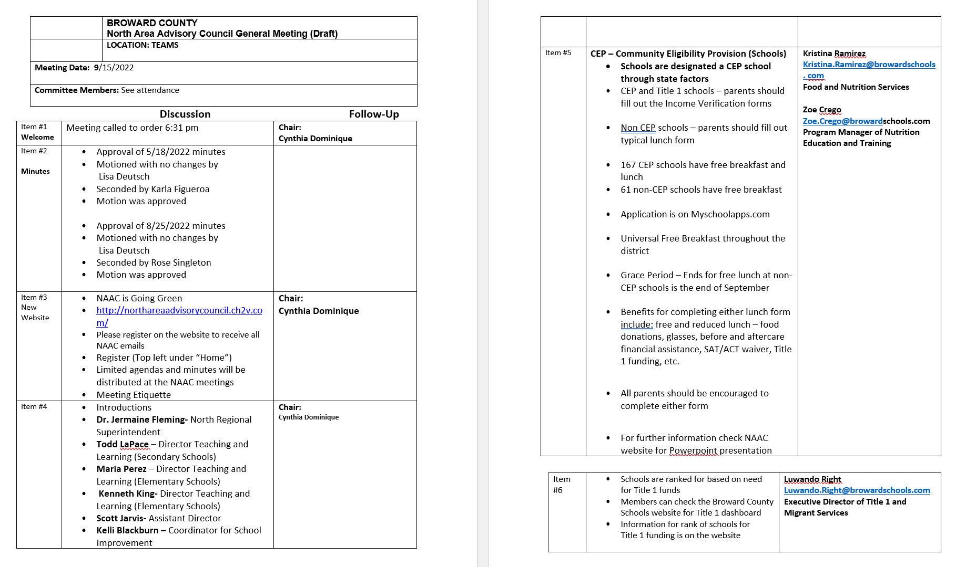

Slide 5
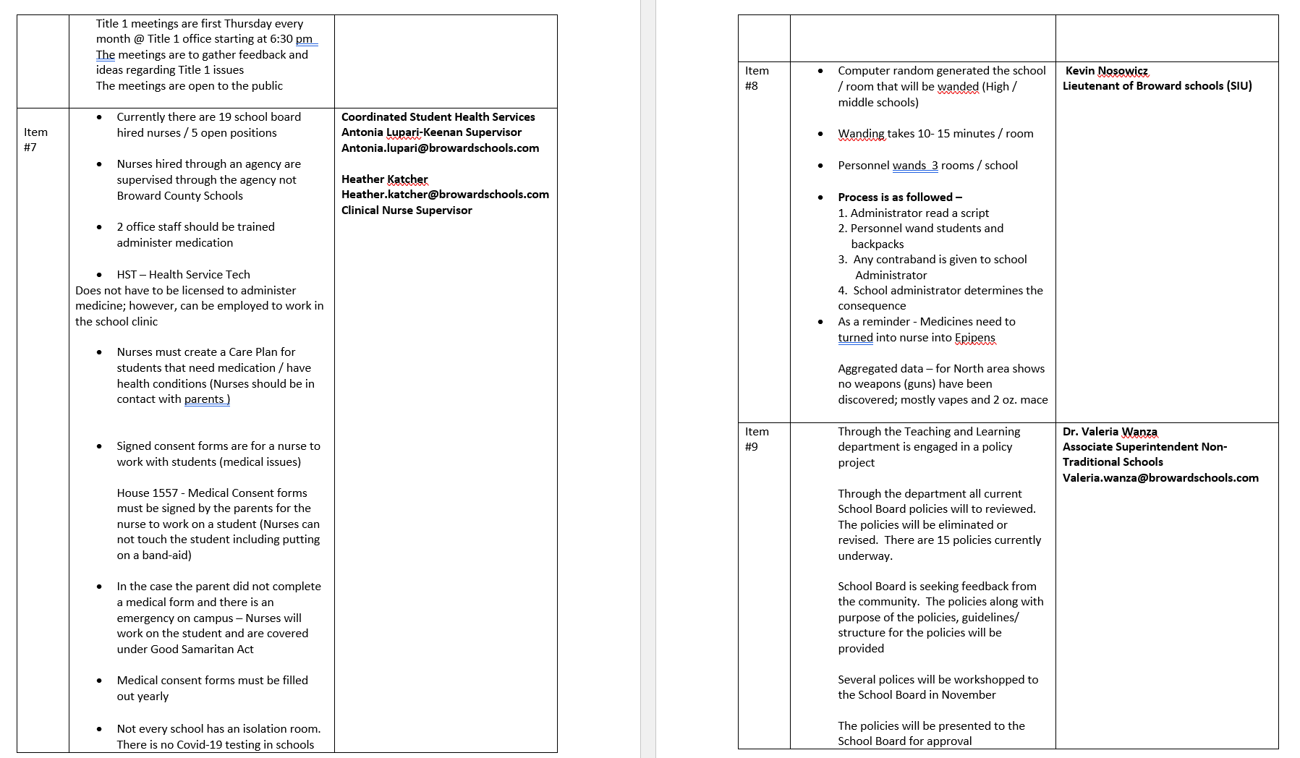

Slide 7
North Area Advisory Representatives

Slide 8
North Region Advisory Representatives
CHAIR - CYNTHIA DOMINIQUE
VICE CHAIR - KARLA FIGUEROA
RECORDING SECRETARY - ROSHANA PARIS
CORRESPONDING SECRETARY - LISA DEUTSCH
---------------------------
ELEMENTARY REP - ROSE SINGLETON & LANETTE RAMOS
MIDDLE SCHOOL REP - LORI TOBON & KARLA FIGUEROA
HIGH SCHOOL REP - LISA DEUTSCH & ALISHA JOHNSON
PARENT AT LARGE - OPEN
CITIZEN AT LARGE - TERESA WILLIAMS
BUSINESS REP - JEFF BOLD
FACILITIES REP – GREG NEMBHARD
TEACHER REP - OPEN
ESE REP- OPEN
GIFTED REP- JESSICA BENNER
ESOL REP- OPEN
LEGISTATIVE REP- OPEN

Slide 9
School Spotlight Corner

Slide 10
Atlantic Technical
Magnet School
Business Clothing Store for Students
Supporting Parenting Representatives through Challenges

Slide 11
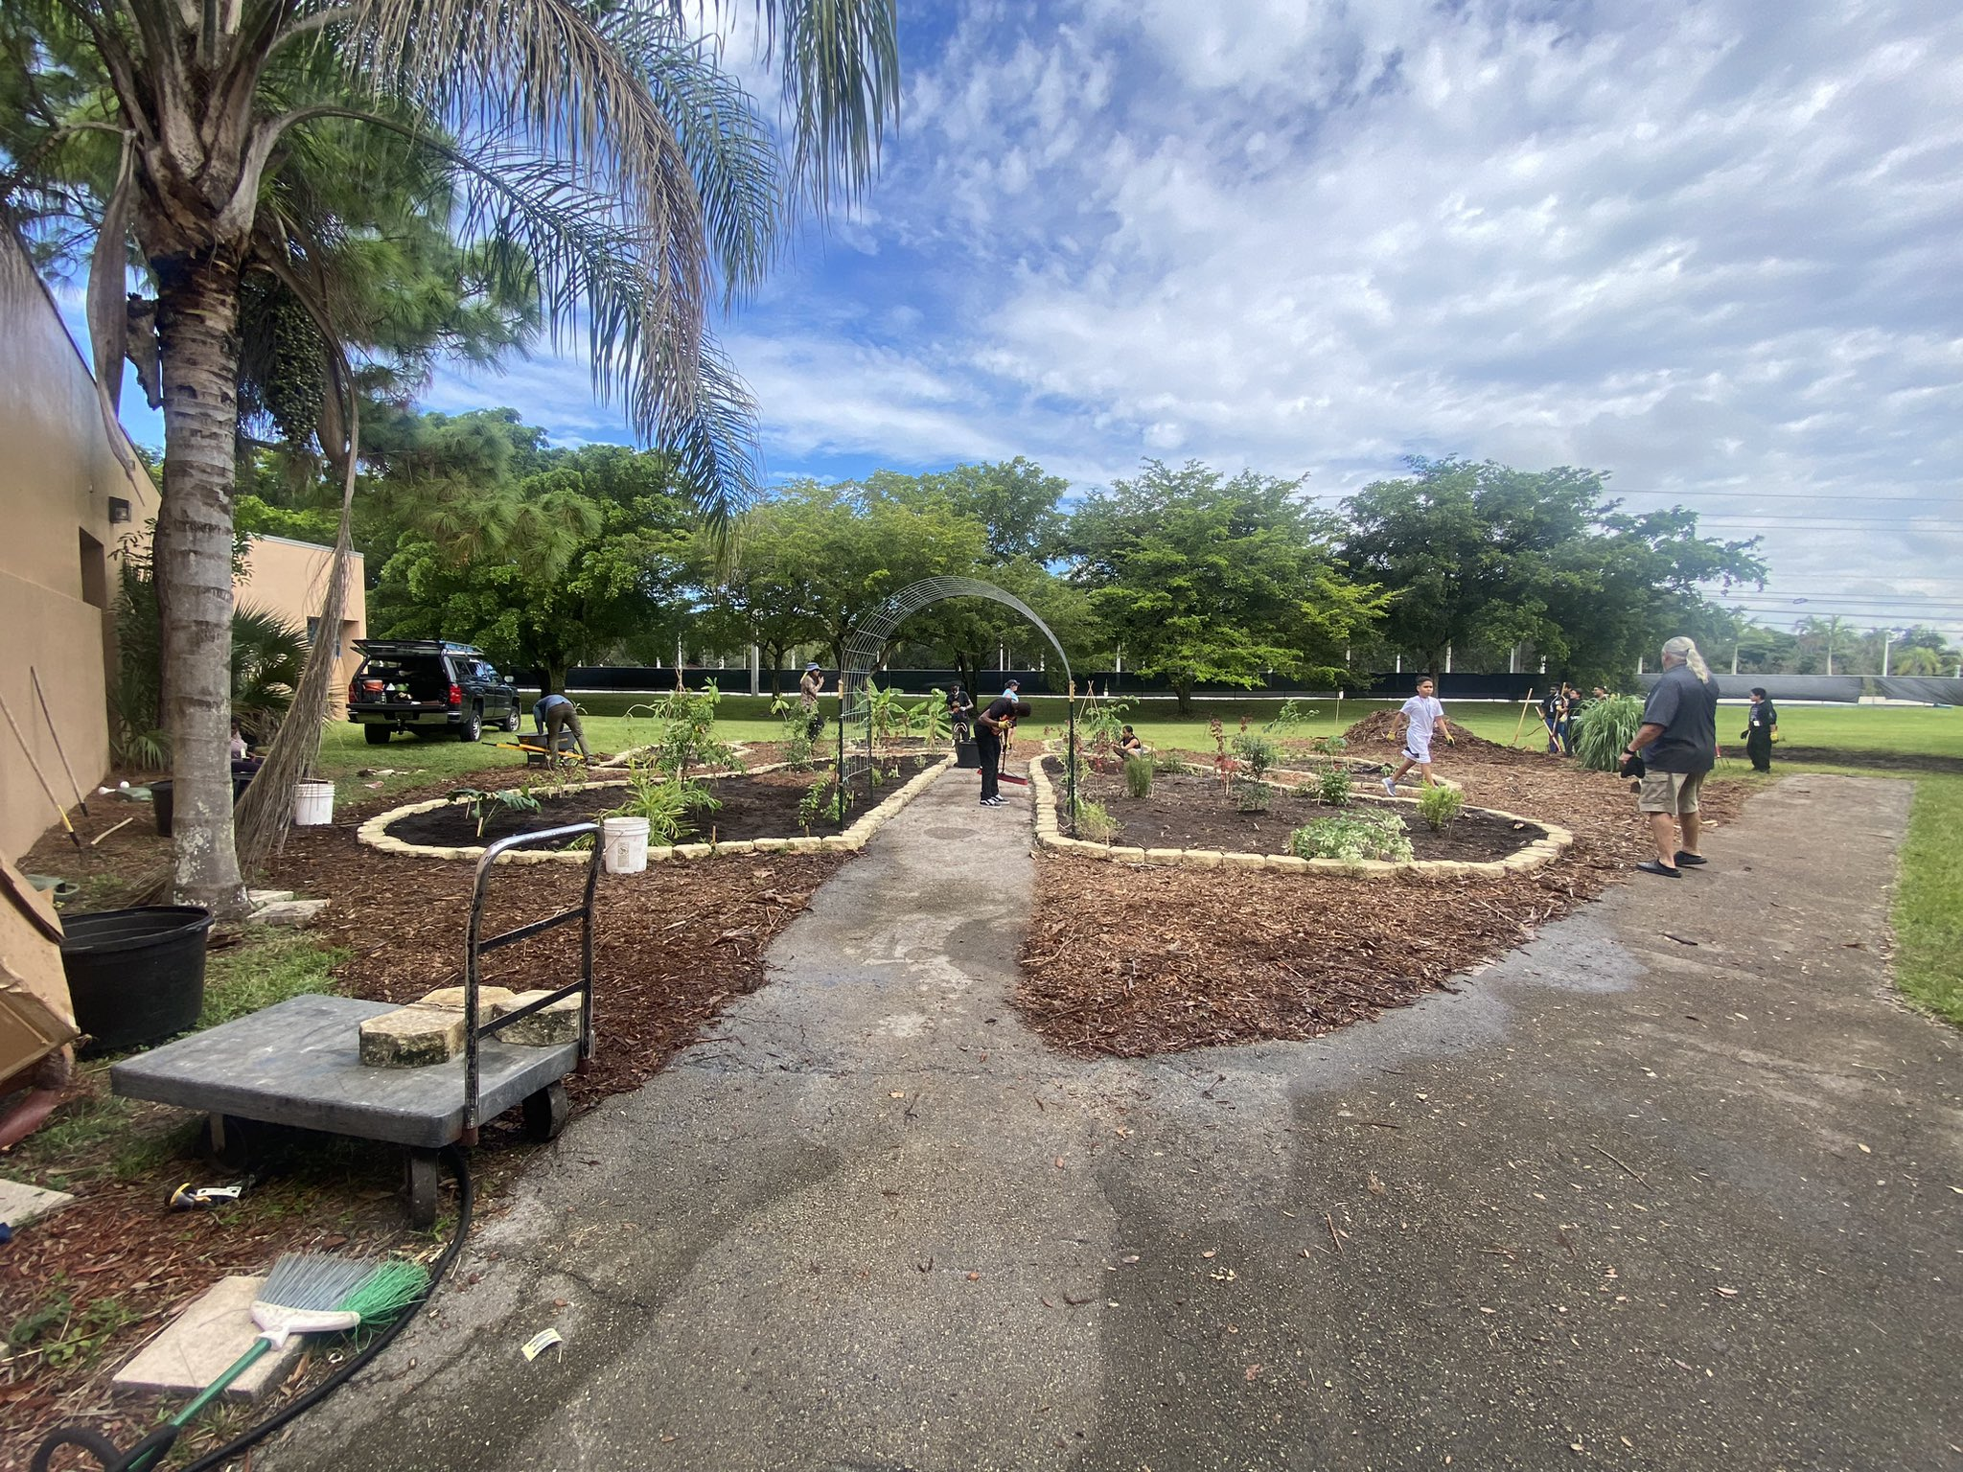
Forest Glen Middle
VILS School (Verizon Innovation Learning School)
provides free iPads, internet access, and innovative learning programs
Food Pantry
Able to serve families facing a difficult time
Peer Counseling Therapy Dog- Ms. Violet
Ms. Violet can be found daily in our Peer Counseling Room planning and preparing for the emotional well-being of all students
New Wildcats Helping Wildcats Resource Center
students in need can get breakfast/lunch items, snacks, water, and hygiene items (has served 75 students in a week's time).
Food Forest Garden

Slide 12
Office of Safety, Security & Emergency Preparedness

Slide 13
See Something, Say Something
Threat Assessment Training Coordinator
BJA Stop School Violence Grant Trainer
sonja.azim@browardschools.com
Direct: 754-321-3537
Safety, Security and Emergency Preparedness / Report a Safety or Security Tip (browardschools.com)

Slide 14
School Safety Probable Cause Searches Random Searches Contraband Concerns
Jaime Alberti,
Chief of Safety, Security and Emergency Preparedness
Jaime.Alberti@browardschools.com;
Office (754) 321-2655
Chief Kowalski,
Special Investigative Unit, Broward County Public Schools Police
craig.kowalski@browardschools.com;
Office: 754-321-0725

Slide 15
SESIR Data
Dr. Fareed Khan Ed.S.,
Assistant Director, Office of Diversity and School Climate (Task Assigned)
Division of Student Services
fareed.khan2@browardschools.com

Slide 16
North Region Updates

Slide 17
MSD School Boundary Update
Public Meeting held Oct 3rd at Coral Springs Middle School
Discussed:
School Boundary and Process
Existing School data/ Factors Impacting enrollment
Projected Residential Development for Coral Springs and Parkland
School Boundary Considerations
Next Steps, including Community Input
MSD has exceeded capacity for a several years
20/21 school year, enrollment was 110% of total capacity
MSD is NOT a school choice option
Boundary Realignment
Enrollment reduction of 300-500 students would provide sufficient relief to MSD
Several options to shift enrollment to surrounding under-enrolled school(s)
Community Input occurring now. Deadline to submit proposal is 10/31/22
BCPS does NOT have any proposals or realignment in place. Strictly looking for public/ community input!!

Slide 18
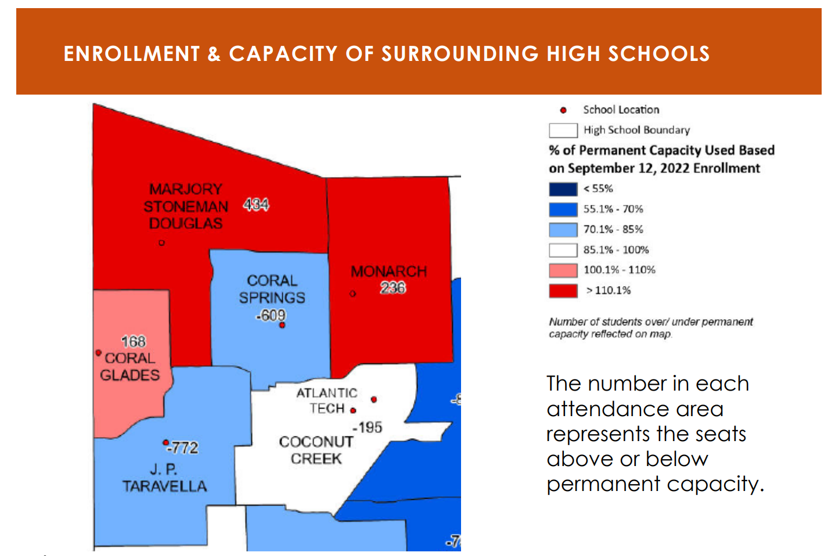
MSD School Boundary Update

Slide 19
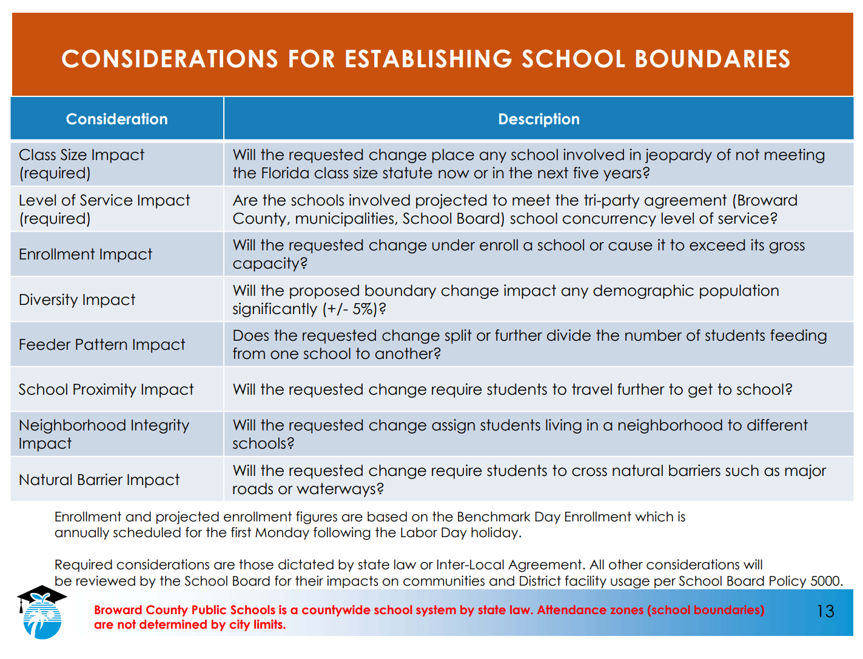

Slide 20
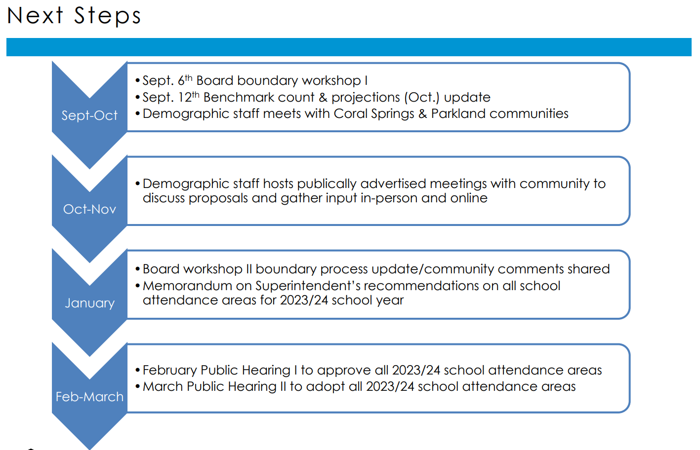
MSD School Boundary Next Steps

Slide 21
MSD School Boundary Next Steps
Next Meeting- Nov 3rd, 6:30pm at Coral Springs Middle School
Live Streamed on Beacon TV
District demographer to present all scenarios
Online comments open until Nov 14
Visit browardschools.com/boundaryprocess for up to date information
How to submit proposals (DEADLINE 10/31)
Current public proposals posted
Provide comments

Slide 22
Ends October 27
https://forms.office.com/r/WGRSG6qAGi

Slide 23
Committee Reports
Chair
Elementary School
Middle School
High School
Facilities Task Force
ESE
Gifted
ESOL

Slide 24
Open Forum
3 P’s
What’s the PROBLEM or POTENTIAL?
What POLICY, PROCESS, or PROCEDURE governs this topic?
What is the PROPOSED RESOLUTION?
Security
Technology
Health
Academics
Innovation/Magnet
Transportation
Facilities
Administrative
SEL

Slide 25
SAF Information
Join North Area Advisory Website and identify your role (s) and school group (Elem, Middle, High)
Returning SAF Chairs, update your information
Create School SAF email (Ex: SAFMargateMiddle@gmail.com); Subject to Sunshine Law
Complete Volunteer Application and Webinar
Complete Ethics Training by October 31st
Complete Anti-bullying Training

Slide 26
SAF Information
Send SAC/SAF Meeting Dates to North Region Advisory; School reps and Chair would like to attend and support
Attend DAC and other meetings (Advisories, tasks forces, etc)
Review/Approve Bylaws at SAF Meeting
Create SAF Binder for yourself (Meeting Dates, Bylaws, Agenda/Minutes, Notes; Principal should have provided you with printed manual, if not, please request it
Have a meeting with your Principal to get to know your school and how he/she would like you to address concerns and how you can disseminate information; walk the school to identify facility issues
Reach out to North Region Chair for any questions or assistance; (954) 461-7469

Slide 27
Call To Action!
What do you do with this information?
Disseminate to your school community (SAC/SAF Meetings, Open Houses, Curriculum Nights, Events, Newsletter)
Are any of the issues discussed here happening at your school or relevant to your school?
Meet with your principal or AP
Send emails to your school board members
Send public comments for agenda items at school board meeting
Share on/Monitor social media platforms

Slide 28
ANNOUNCEMENTS

Slide 30
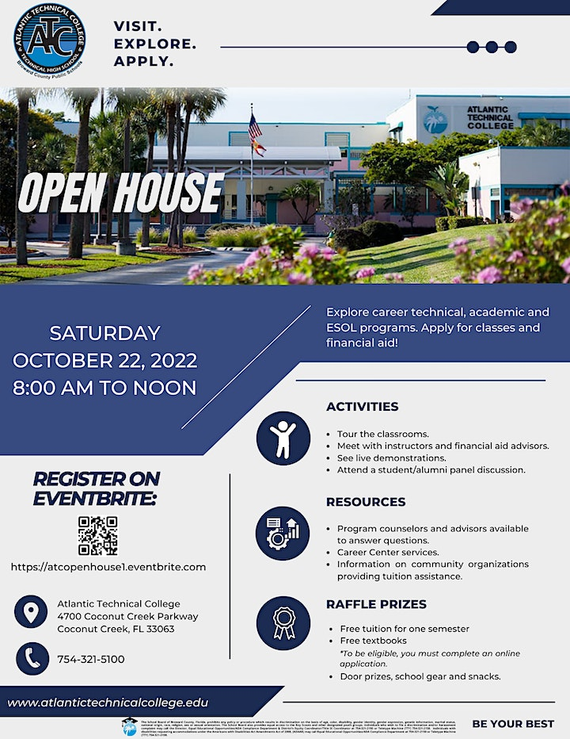

Slide 33
Save the Dates Next Advisory Meetings
MSD Zoning November 3rd @ 6:30pm Coral Springs Middle
North Region STEERING November 3rd @ 5pm Virtual
District Advisory November 9th @ 6:30pm KC Wright Building
Facilities Task Force November 10th @7:00pm Plantation HS
Gifted Advisory November 14th @ 7pm Plantation High
ESE Advisory November 16th @ 6:15pm Location TBD
ESOL Parent Leadership Council
North Region GENERAL November 17th @ 6:30pm Monarch High**

Slide 34
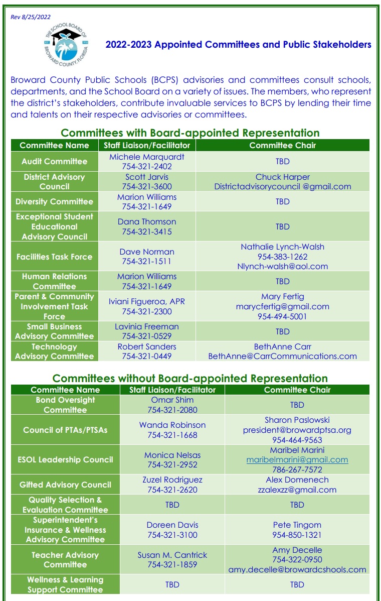
Advisory & Committee Contacts

